Slide 1
Not Night Vision - Single-Pixel Thermal Imaging Solution -
Joshua Alexander
Design Review
EECE 6038C- Advanced Microsystems
Spring 2013

Slide 2
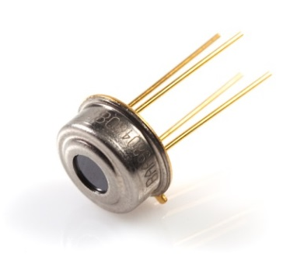
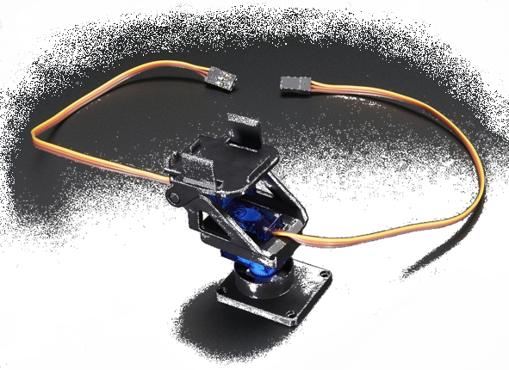
Project Objective
Problem Statement:
The goal of this project is to design and develop a low-cost thermal imaging system using a single-pixel, non-contact thermometer
Hardware needs
MLX90614 sensor
Pan/tilt servo mount
Connectors
Common components
Needed Microcontroller
Features
I²C connectivity
USB connectivity
PIC24FJ
Notes:
Common components - resistors, capacitors, switches
Connectors – PICkit3 header, micro USB female connector
PIC24FJ128GB202-I/SP-ND

Slide 3
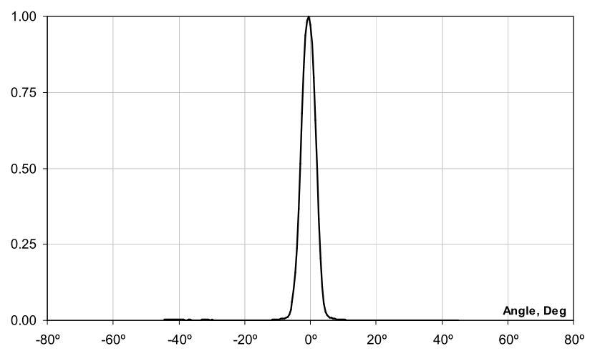
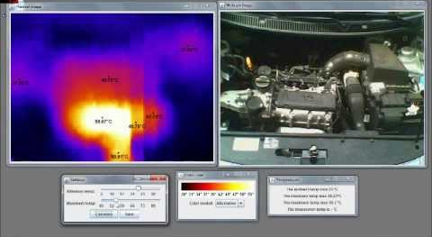
System Design Overview
System Architecture Approach
Look at previous solutions (Cheap Thermocam & IR Eye)
Datasheets, datasheets, datasheets
Prioritize needs of microcontrollers & sensors
Notes:
Prioritize needs – FOV is very important, MLX sensor has many variants and we need the one with the extremely small FOV (5 degrees) to be able to use it as a single-pixel thermometer, this is more important than response time although this would be nice

Slide 4
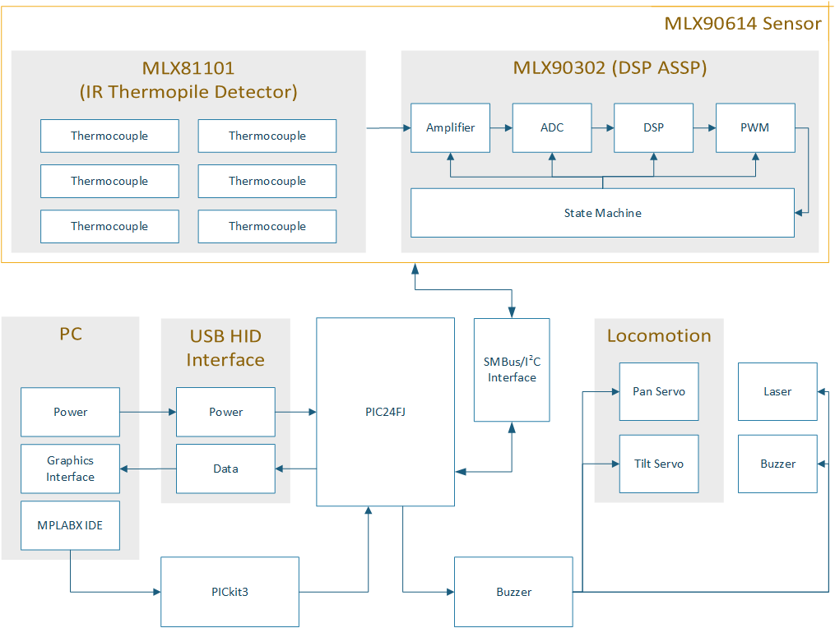
HW System Design

Slide 5
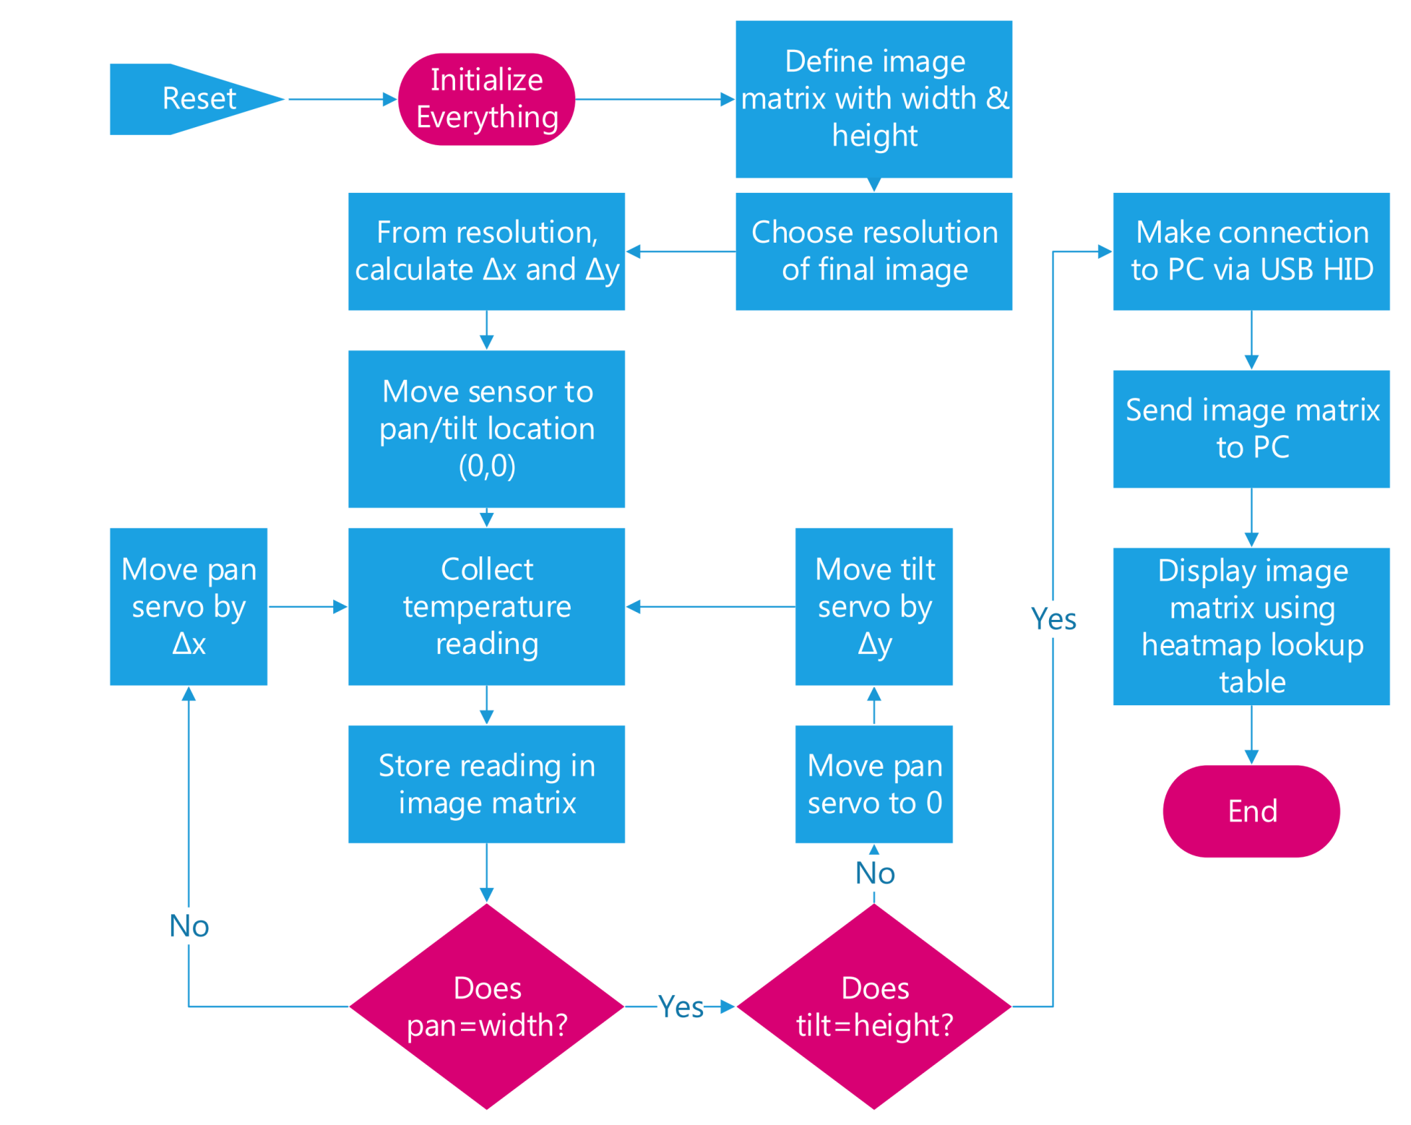
SW System Design

Slide 6
Project Status/Timeline
Hardware components have been ordered from Digi-Key.
Work already done:
Chosen components
Ensured compatibility between components
Created schematic in Eagle CAD
Work to be done:
Prototype system on breadboard
Complete and send out finalized PCB layout
Finish code for final system

Slide 7
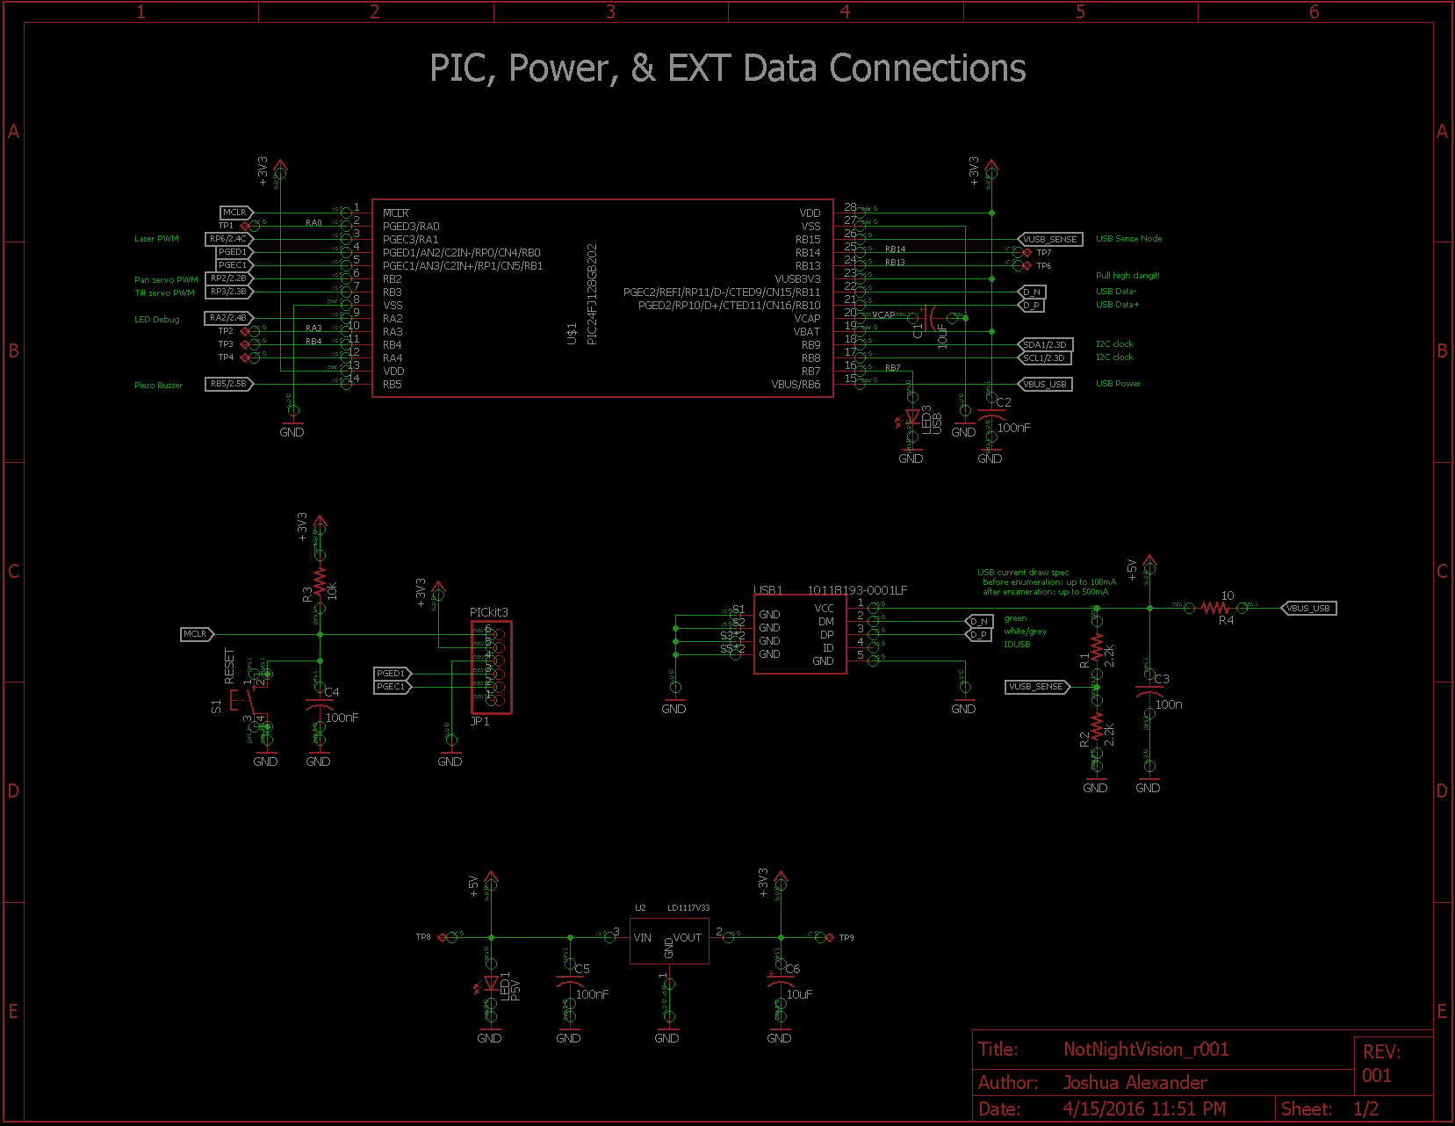

Slide 8
